Slide 1
Development of ANZ Living Guidelines for Cochlear Implant Referral, Candidacy and Outcome Evaluation
Dr Jaime Leigh^{1,2}, Prof Bamini Gopinath³, Prof Catherine McMahon³, Assoc Prof Payal Mukherjee^{4,5}, & ANZ Hearing Health Collaborative Guidelines Working Group
¹ Cochlear Implant Clinic, Royal Victorian Eye and Ear Hospital
² Department of Audiology and Speech Pathology, University of Melbourne
³ Department of Linguistics, Faculty of Medicine, Health and Human Sciences, Macquarie University,
⁴ University of Sydney
⁵ University of Wollongong

Slide 2
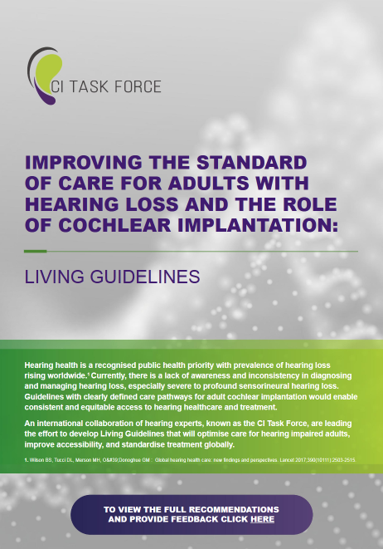
Development of Living Guidelines for CI in Adults
No global guidance or set of guidelines that are applicable for Adult Cochlear Implantation (CI)
Global CI Task Force established in 2021:
  international group of CI users and experts in fields of otology, audiology and hearing science
  established to develop living practice guidelines and guidance that can be adapted and adopted in country, in order to optimise the care for adults indicated for cochlear implants.
  partnership with the Cochlear Implant International Community of Action (CIICA)
Notes:
Background to this initiative is stems from our increased awareness of the burden of hearing loss in the adult population.
And in the context of cochlear implants, knowledge that less than 10% of those who could benefit from CI currently have one.
Poor uptake of CI has been attributed in part to a lack in clarity of who and when to refer for CI candidacy evaluation
Beyond the referral, there is variability in the way a patient is evaluated for a CI, candidacy criteria and follow-up care.
Until this global initiative was established, there was no global guidance or set of guidelines for adult cochlear implantation
Background:
Developing a consistent approach to optimising care for adults experiencing hearing loss who may not receive adequate benefit from hearing aids are essential to overcoming the burden affecting 1 in 5 adults globally¹.
In many countries, adults do not have their hearing assessed as part of regular health check-ups.
Of those who receive hearing checks and are diagnosed with severe, profound, or moderate sloping to profound Sensorineural Hearing Loss (SNHL), few are referred to an appropriately qualified hearing specialist to examine whether an implantable hearing device is indicated as the most beneficial treatment option.³
There is currently no global guidance or set of guidelines that are applicable for Adult Cochlear Implantation (CI).
In 2021, an international group of cochlear implant users and experts in the fields of otology, audiology and hearing science were brought together to form a Task Force in partnership with the Cochlear Implant International Community of Action (CIICA). The Cochlear Implant Task Force (CI Task Force) was established to develop living practice guidelines and guidance that can be adapted and adopted in country, in order to optimise the care for adults indicated for cochlear implants.
1. Buchman et al. Unilateral Cochlear Implants for Severe, Profound, or Moderate Sloping to Profound Bilateral Sensorineural Hearing Loss A Systematic Review and Consensus Statements
2

Slide 3



Global Living Guidelines
The Global Living Guidelines for CI in Adults, which served as the foundation for the ANZ adaptation, were meticulously developed through systematic reviews of existing evidence.
Complemented by the clinical expertise of the Task Force, ensuring a robust and well-informed framework.
Systematic Reviews
Clinical Expertise
Consumer Feedback
Evidence-based recommendations from thorough research
Insights from experienced professionals in the field
Valuable perspectives from individuals with lived experience
Reference: https://adulthearing.com/living-guidelines/
Notes:
Three fundamental aspects to the development of the Living Guidelines
To ensure the guidelines were based on evidence, through systematic review was conducted
This was then complemented by the clinical expertise of the CI Task Force, who add the valuable clinical context to the guidelines, looking at it from the lens of what is practical in a clinical setting
And most importantly, the perspective of those with lived experience who are the end users of our clinical services, we want to ensure that our guidelines reflect their needs and preferences
Background:
Developing a consistent approach to optimising care for adults experiencing hearing loss who may not receive adequate benefit from hearing aids are essential to overcoming the burden affecting 1 in 5 adults globally¹.
In many countries, adults do not have their hearing assessed as part of regular health check-ups.
Of those who receive hearing checks and are diagnosed with severe, profound, or moderate sloping to profound Sensorineural Hearing Loss (SNHL), few are referred to an appropriately qualified hearing specialist to examine whether an implantable hearing device is indicated as the most beneficial treatment option.³
There is currently no global guidance or set of guidelines that are applicable for Adult Cochlear Implantation (CI).
In 2021, an international group of cochlear implant users and experts in the fields of otology, audiology and hearing science were brought together to form a Task Force in partnership with the Cochlear Implant International Community of Action (CIICA). The Cochlear Implant Task Force (CI Task Force) was established to develop living practice guidelines and guidance that can be adapted and adopted in country, in order to optimise the care for adults indicated for cochlear implants.
3

Slide 4
Standardised Guidelines for Adult Cochlear Implantation in ANZ
Inconsistent hearing loss management, particularly in aftercare, highlights the need for standardised guidelines in Australia and New Zealand (ANZ)
The ANZ Hearing Health Collaborative (HHC), formed in 2021 with 70+ volunteer members, is developing patient-focused best practice guidelines for adult cochlear implantation
This initiative aims to improve equitable access to quality hearing healthcare and achieve positive outcomes
By providing clear, evidence-based recommendations, the HHC seeks to reduce disparities and improve the quality of life for adults with hearing impairment
Notes:
Inconsistent hearing loss management, particularly in aftercare, highlights the need for standardised guidelines in Australia and New Zealand (ANZ)
The ANZ Hearing Health Collaborative (HHC), formed in 2021 with 70+ volunteer members, is developing patient-focused best practice guidelines for adult cochlear implantation
Aims of the HHC are aligned with the Global CI task force…… this initiative aims to improve equitable access to quality hearing healthcare and achieve positive outcomes
By providing clear, evidence-based recommendations, the HHC seeks to reduce disparities and improve the quality of life for adults with hearing impairment
4

Slide 5




















ANZ HHC Structure
‘Coalition of the willing’ lead by four Co-Chairs
70+ volunteer members, including those with lived experience, expertise in audiology, and broader hearing health care
Catherine McMahon
Jaime Leigh
Payal Mukherjee
Bamini Gopinath
ANZ HHC Co-chairs
ANZ HHC Members
Advocacy
Guidelines
Education

Slide 6




Adapting Global Guidelines for ANZ context
Guidelines Working Group formed in October 2023 as a volunteer subgroup of ANZ HHC.
Purpose: To review and adapt the Global Living Guidelines for the ANZ context as they relate to the areas of CI referral, CI evaluation, CI candidacy recommendation, and CI outcome evaluation.
CI Referral
CI Evaluation
CI Candidacy
CI Outcome Evaluation
Streamlining the referral process for cochlear implant evaluations
Ensuring thorough and standardised evaluation protocols
Providing clear guidelines for candidacy recommendations
Measuring and evaluating the effectiveness of CI outcomes
Notes:
Objective:
A working group of experts was formed to adapt the Global Living Guidelines for CI, released in 2023, to the ANZ context, focusing on:
CI referral, evaluation, candidacy recommendation, and outcome evaluation.
Guidelines Working Group formed in October 2023 as a volunteer subgroup of ANZ HHC.
Purpose:
To review and adapt the global Living Guidelines for the ANZ context as they relate to the areas of CI referral, CI evaluation and candidacy recommendation, and CI outcome evaluation.
This is a subset of work which will be subsequently be done on broader guideline development for adults with hearing loss.
Role and Scope:
The working group will:
Review the global Living Guidelines, consider relevance for the ANZ context and adapt accordingly
Address the areas of:
CI referral
CI evaluation and candidacy recommendation
CI outcome evaluation
Present the recommended ANZ guidelines to the ANZ Hearing Health Collaborative for endorsement
Support the Advocacy and Education working groups to disseminate and promote the adoption of the ANZ guidelines
6

Slide 7
ANZ HHC Guideline Working Group
Name | Role | Organisation(s) | Location (primary)
Jaime Leigh | WG Lead / Audiologist | Royal Victorian Eye & Ear Hospital | VIC
Holly Teagle | Audiologist | The Hearing House, University of Auckland | Auckland, NZ
Mel Ferguson | Audiologist | Curtin University | WA
Cathy Sucher | Audiologist | Fiona Stanley Fremantle Hospital Group (Royal Perth Hospital), University of WA, Curtin University | WA
Emma Scanlan | Audiologist | Hearing Australia | NSW
Colleen Psarros | Audiologist | Macquarie University, Cochlear | NSW
Nina Swiderski | Audiologist | Cochlear Implants SA (formally SACIC) | SA
Katie Neal | Audiologist / Consumer | The Shepherd Centre | NSW
Jane Brew | Audiologist | NextSense | NSW
Eleanor McKendrick | Audiologist | NextSense | NSW
Dayse Tavora-vieira | Audiologist | Fiona Stanley Fremantle Hospital Group | WA
Claire Iseli | ENT surgeon / Otologist | Royal Victorian Eye & Ear Hospital, Royal Children’s Hospital, University of Melbourne | VIC
Jafri Kuthubutheen | ENT surgeon / Otologist | Fiona Stanley Hospital, Perth Children’s Hospital, Sir Charles Gairdner Hospital, WA Country Health Service, Western ENT, University of WA | WA
Payal Mukherjee | ENT surgeon / Otologist | University of Sydney, Macquarie University, University of Wollongong, Royal Prince Alfred Hospital, Sydney Adventist Hospital, ENT Care Sydney | NSW
Mike Bergin | ENT surgeon / Otologist | Southern Cochlear Implant Program | NZ

Slide 8






Workshop 3
CI surgeon consultation
13 Dec 2023
Jul-Aug 2024
Recap workshop 1 & 2, CI Referral Guidelines and Evaluation Guidelines
Offline review of medical/otological guidelines by CI surgeon reps
Final draft
Workshop 1
Consumer perspective
Feb 2025
Audiological candidacy guidelines
WG endorsement
Achieved >85% agreement
14 Nov 2023
Redraft Guidelines
Guidelines for referral for CI evaluation
Medical/Otological evaluation and candidacy guidelines
Sep 2024
Incorporate feedback from WG consultation
Guidelines for re-referral
Patient outcome and measures
Workshop 2:
Draft out for WG consultation
29 Nov 2023
Workshop 4
Recap workshop 1, CI referral guidelines
31 Jan 2024
Aug 2024
Workshop 5
Recap workshops 1, 2 & 3
10 Oct 2024
Audiological evaluation and candidacy
Plan for consumer perspective
Review residual feedback
Medical/Otological evaluation and candidacy guidelines
Discuss areas of contention and reach consensus
ANZ adaptation of Global Living Guidelines
Notes:
The ANZ working group further refined these guidelines through a series of five workshops held throughout 2023 and 2024.
8

Slide 9



Advancing the ANZ CI Guidelines
1
2022
3
2023-2024
5
2025
ANZ Hearing Health Collaborative inaugural meeting
ANZ Working Group Adapts Guidelines
Guidelines revised based on feedback
BACKGROUND
DEVELOPMENT
IMPLEMENTATION
2
2023
4
2025
6
Future
Global Living Guidelines for CI released
Draft Guidelines released for Public and Industry Consultation
Implementation and Evaluation
Ongoing Evolution with New Evidence

Slide 10
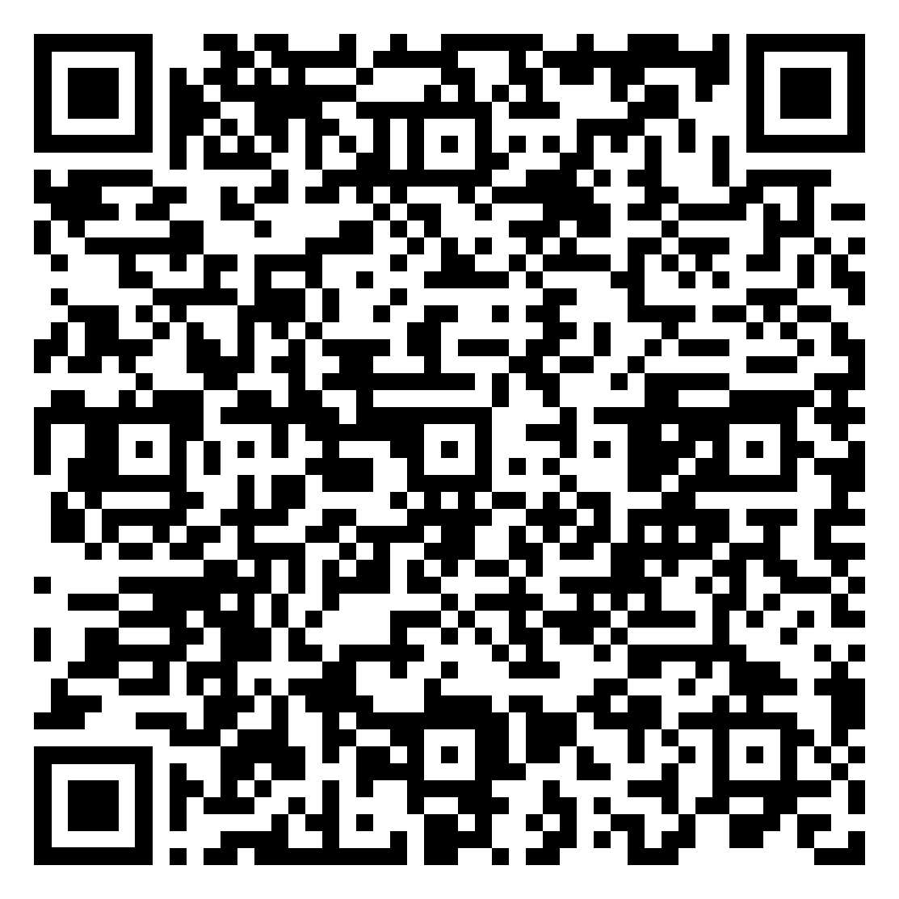
We invite your feedback
We invite you to review these ANZ draft guidelines and provide feedback to ensure they align with the needs of ANZ audiology professionals and the broader hearing health community.
How to Provide Feedback:
Please scan the QR code
Download the attached document
Add your comments
Return your completed feedback to anzguidelines@adulthearing.com
Thank-you

